Slide 1
winegression of the vinho verde region
Predicting alcohol content by analyzing physiochemical properties

Slide 2
Process
Data Source | Checking for multicollinearity, homoscedasticity | Transforming | Feature Engineering | Modeling | Adjust/Assess
Kaggle | Heatmap, scatter plots | Scaling & log | Grouping by: pH res. sugar SO₂ | OLS regression | Ridge No Lasso QQ plot

Slide 3
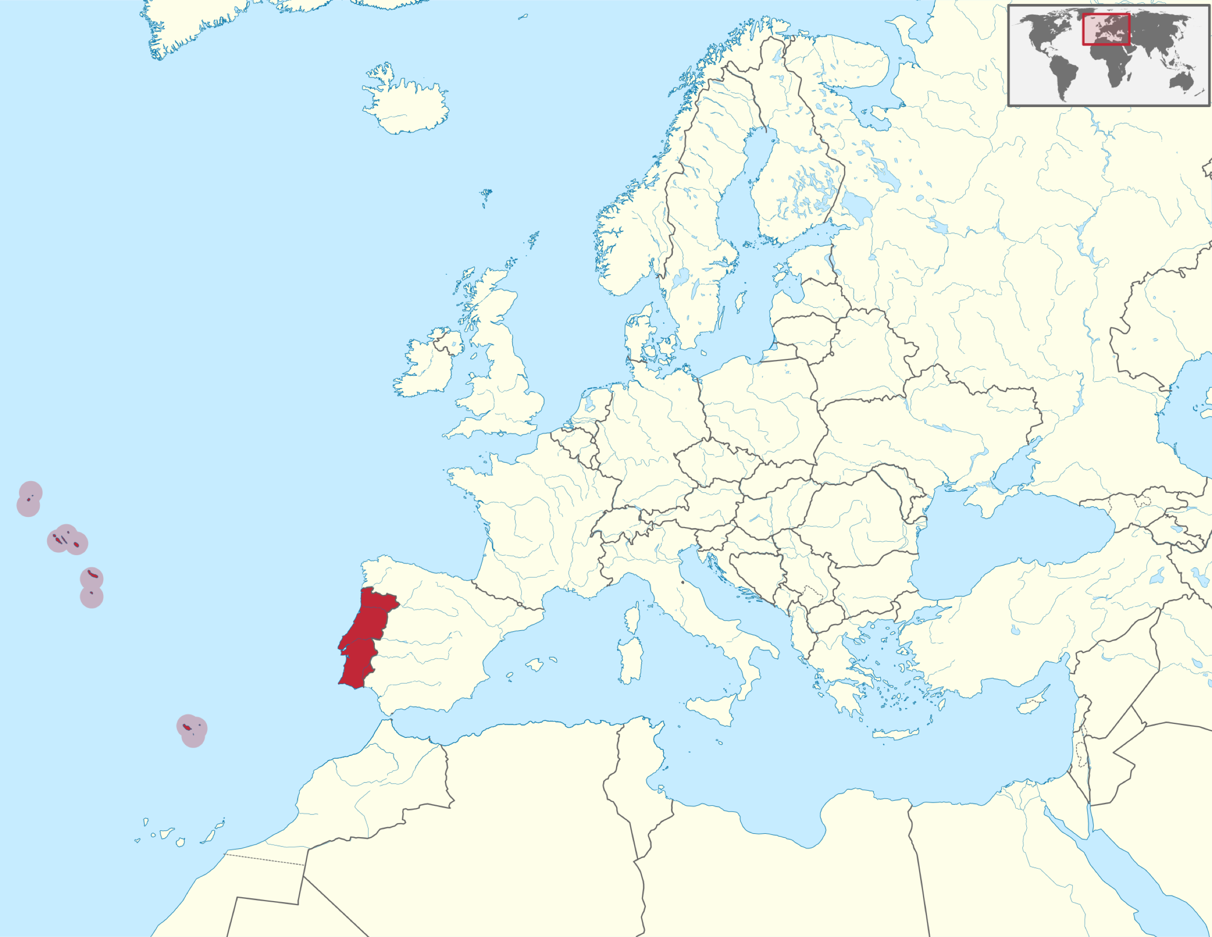
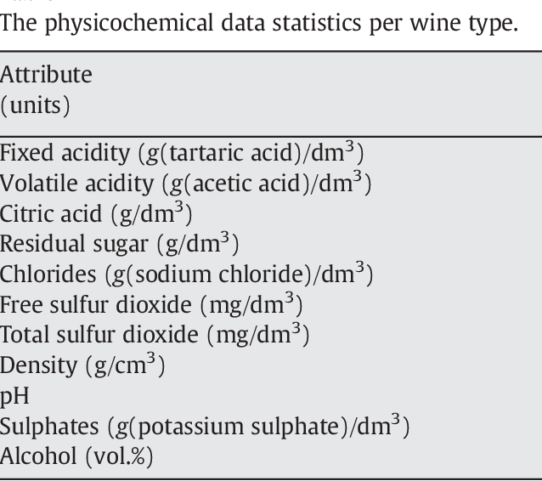
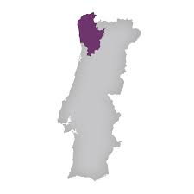
Vinho Verde
Collected from study analyzing physiochemical properties of wine

Slide 4
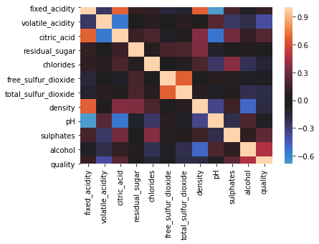
No multicollinearity

Slide 5
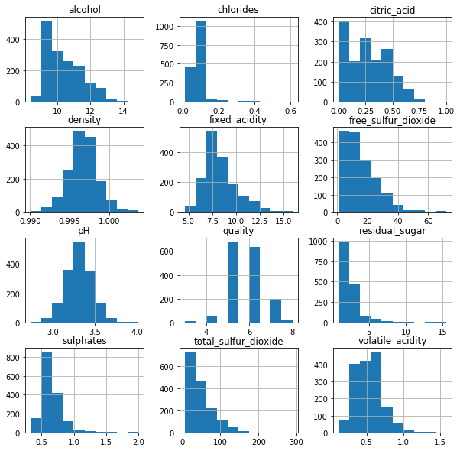
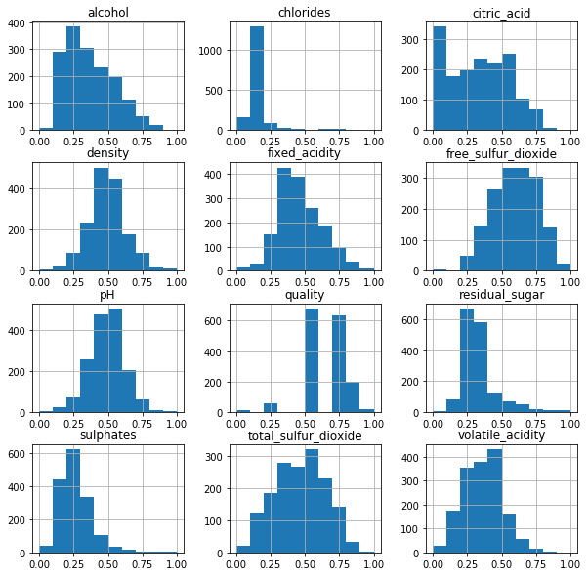
Standardized Data: (scaled + log transformed)
Original Data:

Slide 6
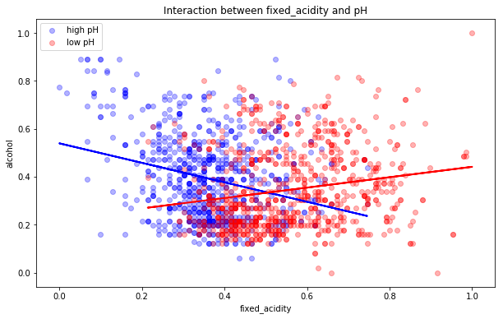
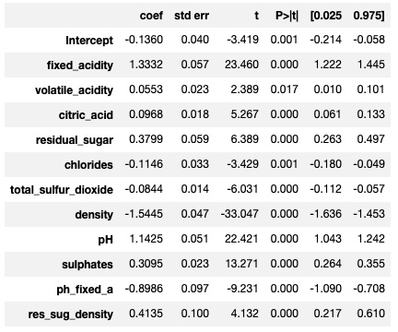
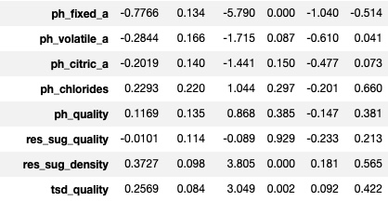
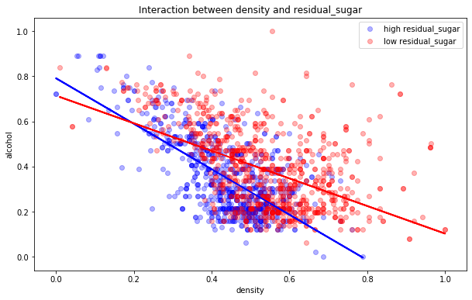
Feature Engineering Evidence of variable interaction that improved our model

Slide 7
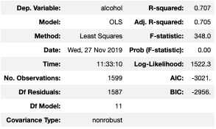
OLS Model Results (logged and scaled)

Slide 8
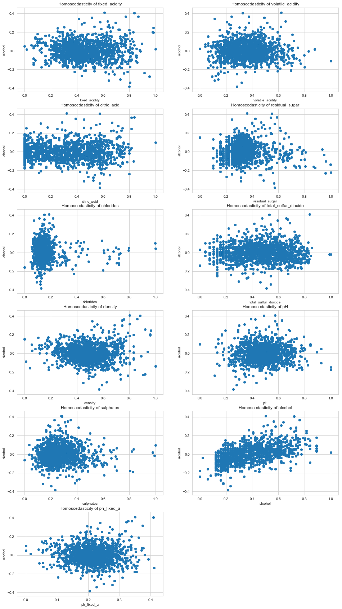
Evidence of lacking homoscedasticity

Slide 9
Evidence of lacking homoscedasticity?
Variance is consistent for most of our data
Our model might not be as useful for extreme data

Slide 10
Evidence of lacking homoscedasticity

Slide 11
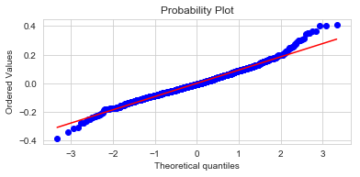
Q-Q plot Further evidence of our model shortcomings at extreme data values

Slide 12
Conclusions
This model might be useful in the field to determine when to harvest grapes
Must keep in mind that the alcohol output of this model is both log transformed and scaled (relationship vs. value)
Use caution when data falls in extreme zones

